Slide 1

Vertical Position Reconstruction Update
Analysis Meeting 7 March 2024
Sam Pratt

Slide 2
Overview
Work done previously on deceleration effect
New deceleration results from using Bismuth Sources
Next steps
Work done previously on timestamp correction effects
New timestamp results from using Bismuth Sources
Next steps

Slide 3
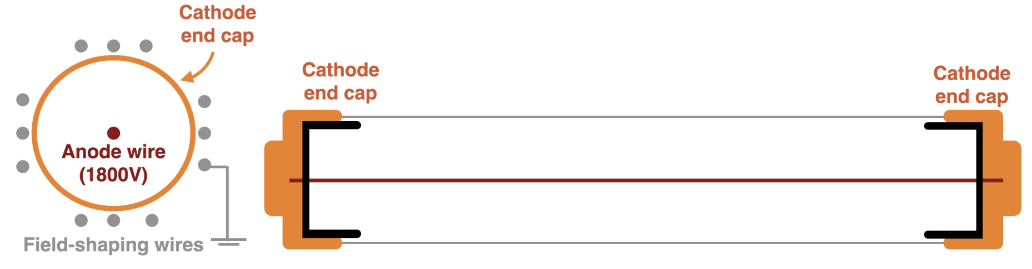
Overview of Current Reconstruction
Cell View
Cathode end cap
Anode wire
Cathode end cap

Slide 4
Overview of Tracker Cell
Cell View
Measured Signals
Recorded Information
Anode
T0 - Anode
T1,T2 - Anode
Ttop Cathode
T3,T4 –Anode
Tbot – Cathode
Cathode 1
e-
Cathode 2
Time
Time

Slide 5
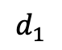
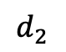
Reconstruction Procedure
H
h
$$d_{1}$$
$$d_{2}$$

Slide 6
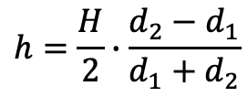
Reconstruction Procedure
Height Calculation
$$h=\frac{H}{2}∙\frac{d_{2}−d_{1}}{d_{1}+d_{2}}$$
H
h
$$d_{1}$$
$$d_{2}$$

Slide 7


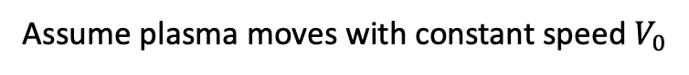
Reconstruction Procedure
Height Calculation
$$h=\frac{H}{2}∙\frac{d_{2}−d_{1}}{d_{1}+d_{2}}$$
H
Assume plasma moves with constant speed $V_{0}$
h
$$d_{2}=V_{0}(t_{top}−t_{0})$$
$$d_{1}=V_{0}(t_{bot}−t_{0})$$
$$d_{1}$$
$$d_{2}$$

Slide 8
Reconstruction Procedure
Anode
Height Calculation
$$h=\frac{H}{2}∙\frac{d_{2}−d_{1}}{d_{1}+d_{2}}$$
H
t0
Cathode 1
Assume plasma moves with constant speed $V_{0}$
h
$$d_{2}=V_{0}(t_{top}−t_{0})$$
$$d_{1}=V_{0}(t_{bot}−t_{0})$$
$$d_{1}$$
$$d_{2}$$
tbot
Cathode 2
ttop
Time

Slide 9
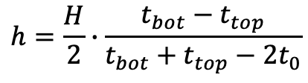
Reconstruction Procedure
Anode
Height Calculation
$$h=\frac{H}{2}∙\frac{d_{2}−d_{1}}{d_{1}+d_{2}}$$
H
t0
Cathode 1
Assume plasma moves with constant speed $V_{0}$
h
$$d_{2}=V_{0}(t_{top}−t_{0})$$
$$d_{1}=V_{0}(t_{bot}−t_{0})$$
$$d_{1}$$
$$d_{2}$$
tbot
Cathode 2
Current height formula
$$h=\frac{H}{2}∙\frac{t_{bot}−t_{top}}{t_{bot}+t_{top}−2t_{0}}$$
ttop
Time

Slide 10
Assumptions made in reconstruction
Constant plasma speed:

Slide 11
Assumptions made in reconstruction
Constant plasma speed:
Timestamps do not need to be corrected before being used in reconstruction
Voltage
Time

Slide 12
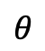
Assumptions made in reconstruction
Constant plasma speed:
Timestamps do not need to be corrected before being used in reconstruction
Voltage
Time
Angle of track doesn’t affect our ability to reconstruct
$$θ$$

Slide 13
Plasma Deceleration Effect

Slide 14
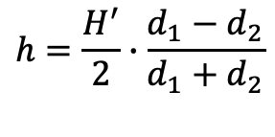
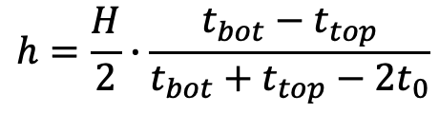
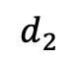
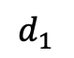
Assumption 1 – Constant Plasma Speed
Previously assumed plasma moves with constant speed
H
h
$$h=\frac{H^{′}}{2}∙\frac{d_{1}−d_{2}}{d_{1}+d_{2}}$$
$$h=\frac{H}{2}∙\frac{t_{bot}−t_{top}}{t_{bot}+t_{top}−2t_{0}}$$
$$d_{1}$$
$$d_{2}$$

Slide 15
Assumption 1 – Constant Plasma Speed
Previously assumed plasma moves with constant speed
Expect plasma to decelerate due to voltage drop over anode
H
h
$$h=\frac{H^{′}}{2}∙\frac{d_{1}−d_{2}}{d_{1}+d_{2}}$$
$$h=\frac{H}{2}∙\frac{t_{bot}−t_{top}}{t_{bot}+t_{top}−2t_{0}}$$
$$d_{1}$$
$$d_{2}$$

Slide 16
Assumption 1 – Constant Plasma Speed
Previously assumed plasma moves with constant speed
Expect plasma to decelerate due to voltage drop over anode
NEMO-3 accounted for this effect using a correction term
H
h
$$h=\frac{H^{′}}{2}∙\frac{d_{1}−d_{2}}{d_{1}+d_{2}}$$
$$h=\frac{H}{2}∙\frac{t_{bot}−t_{top}}{t_{bot}+t_{top}−2t_{0}}$$
$$d_{1}$$
$$d_{2}$$

Slide 17
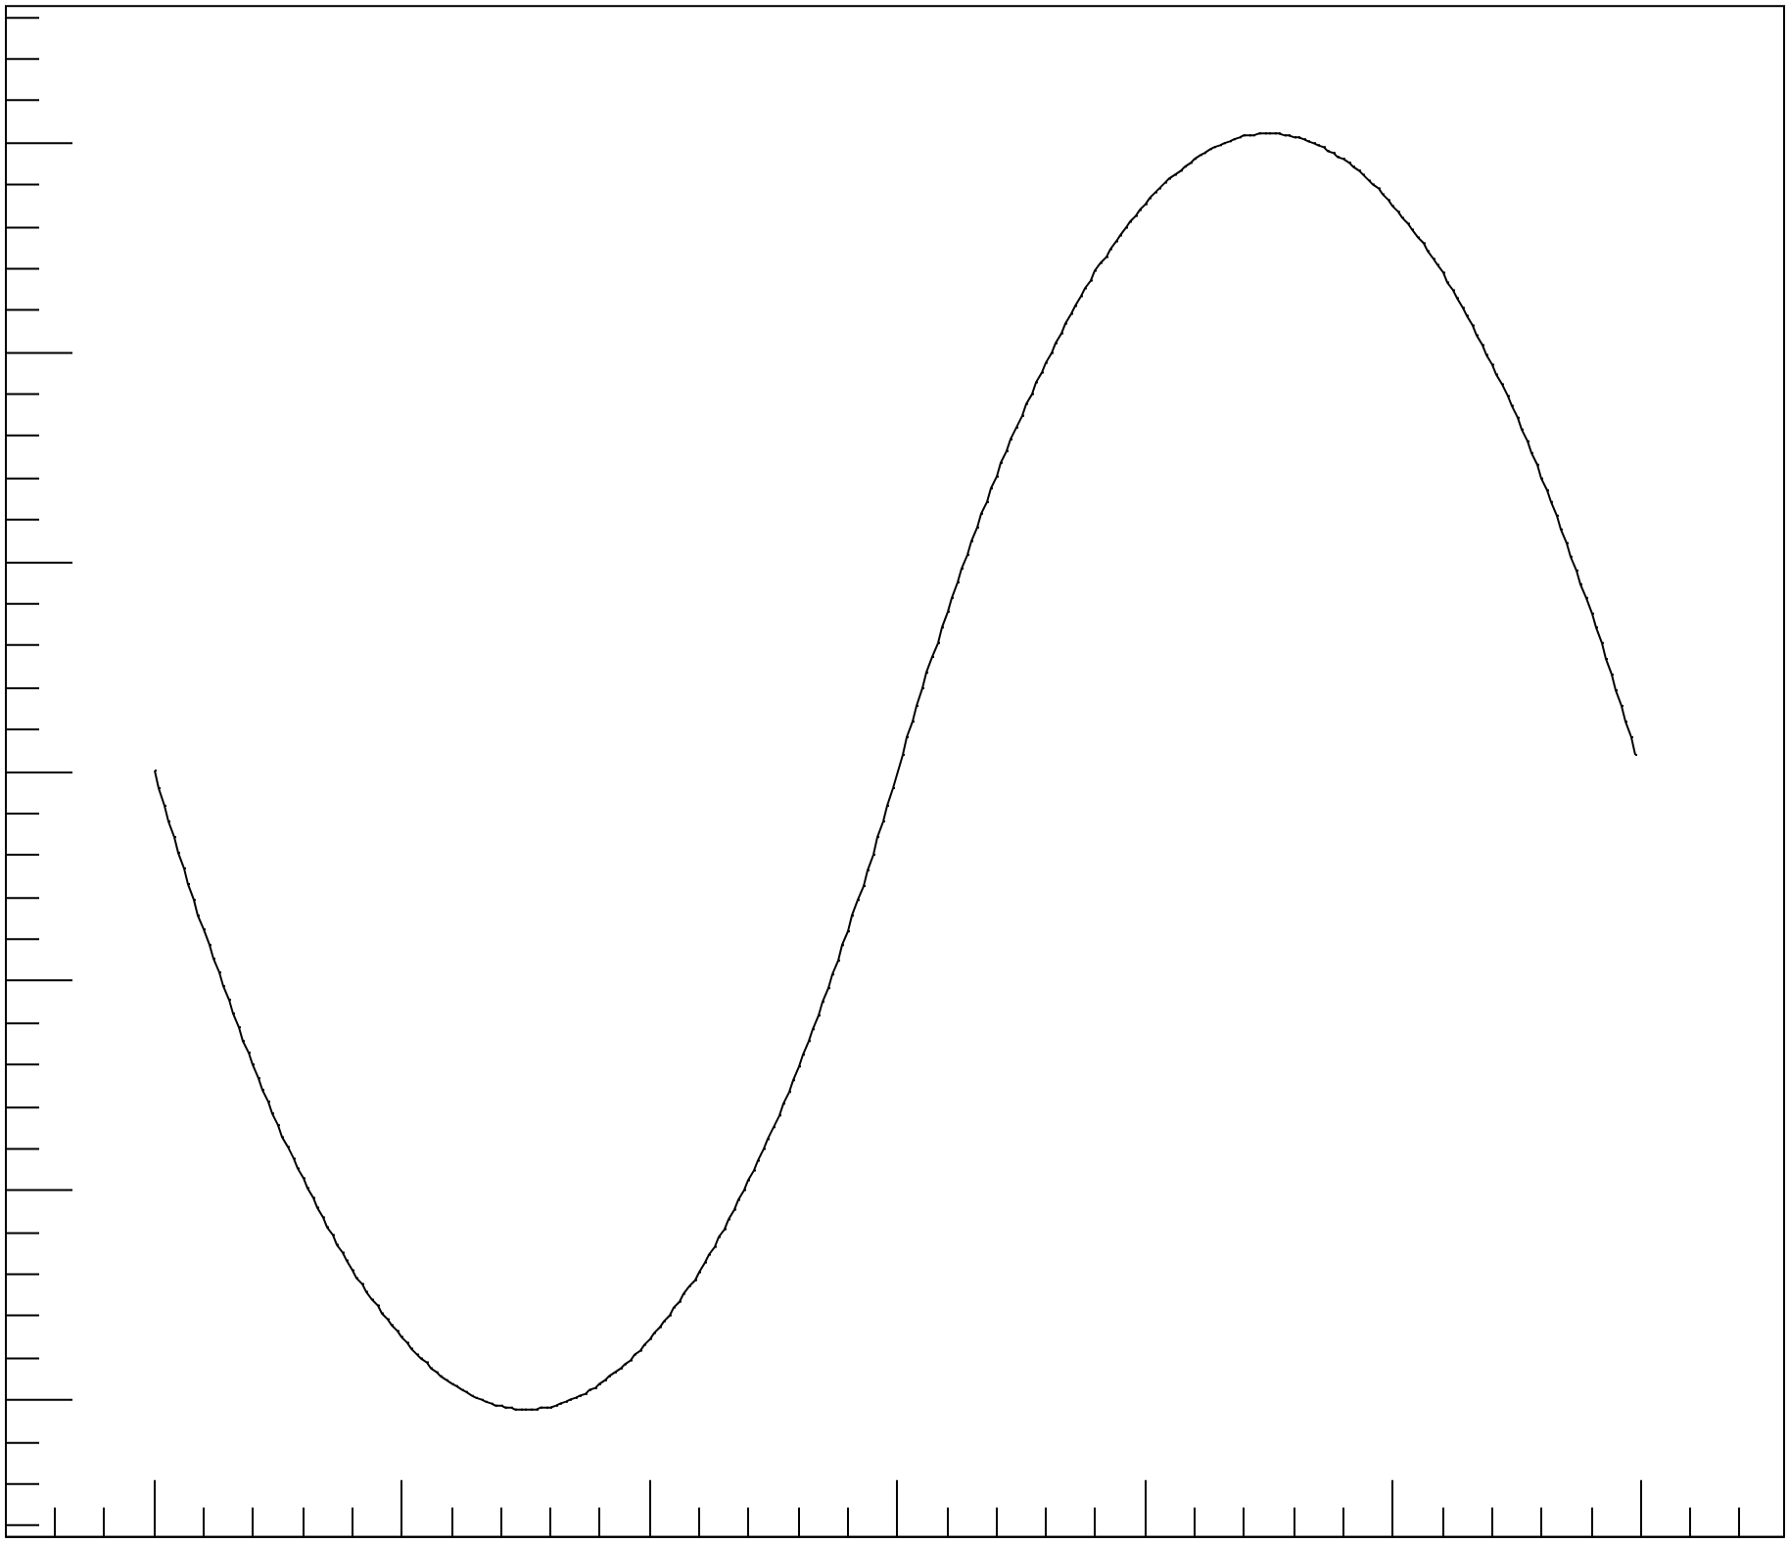
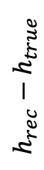
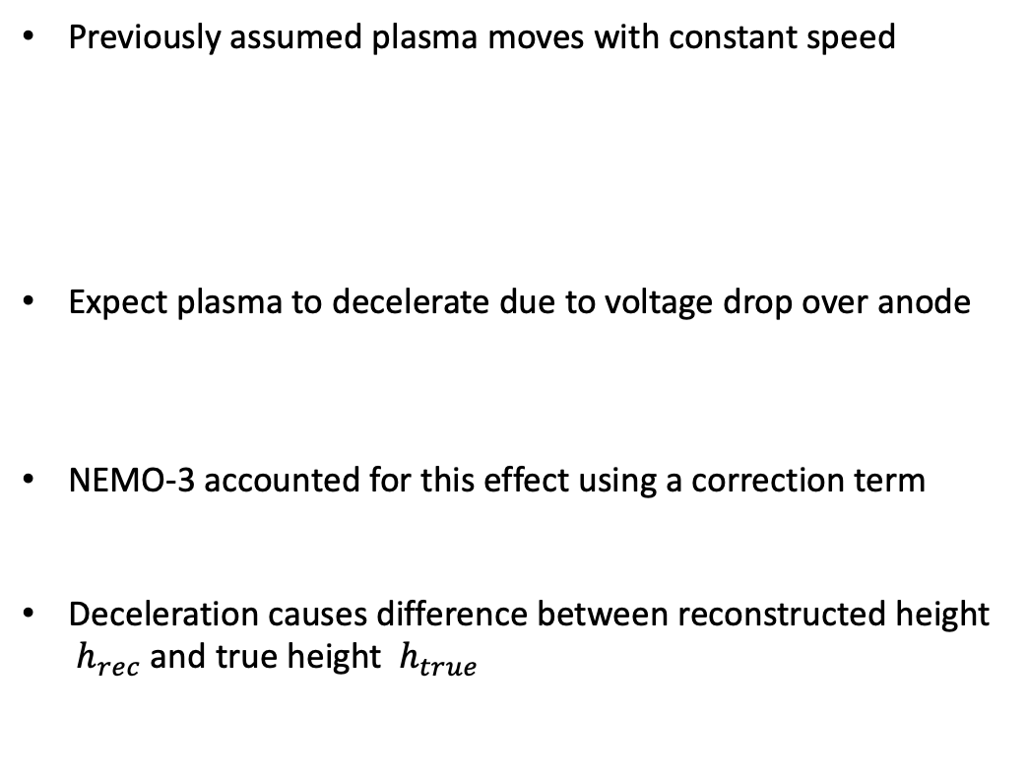
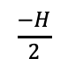
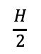
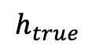
Assumption 1 – Constant Plasma Speed
Previously assumed plasma moves with constant speed
Expect plasma to decelerate due to voltage drop over anode
NEMO-3 accounted for this effect using a correction term
Deceleration causes difference between reconstructed height ${ h}_{rec}$ and true height${ h}_{true}$
H
h
$$h=\frac{H^{′}}{2}∙\frac{d_{1}−d_{2}}{d_{1}+d_{2}}$$
$$h=\frac{H}{2}∙\frac{t_{bot}−t_{top}}{t_{bot}+t_{top}−2t_{0}}$$
$$d_{1}$$
$$d_{2}$$
$$h_{rec}−h_{true}$$
$$\frac{−H}{2}$$
$$h_{true}$$
$$\frac{H}{2}$$

Slide 18
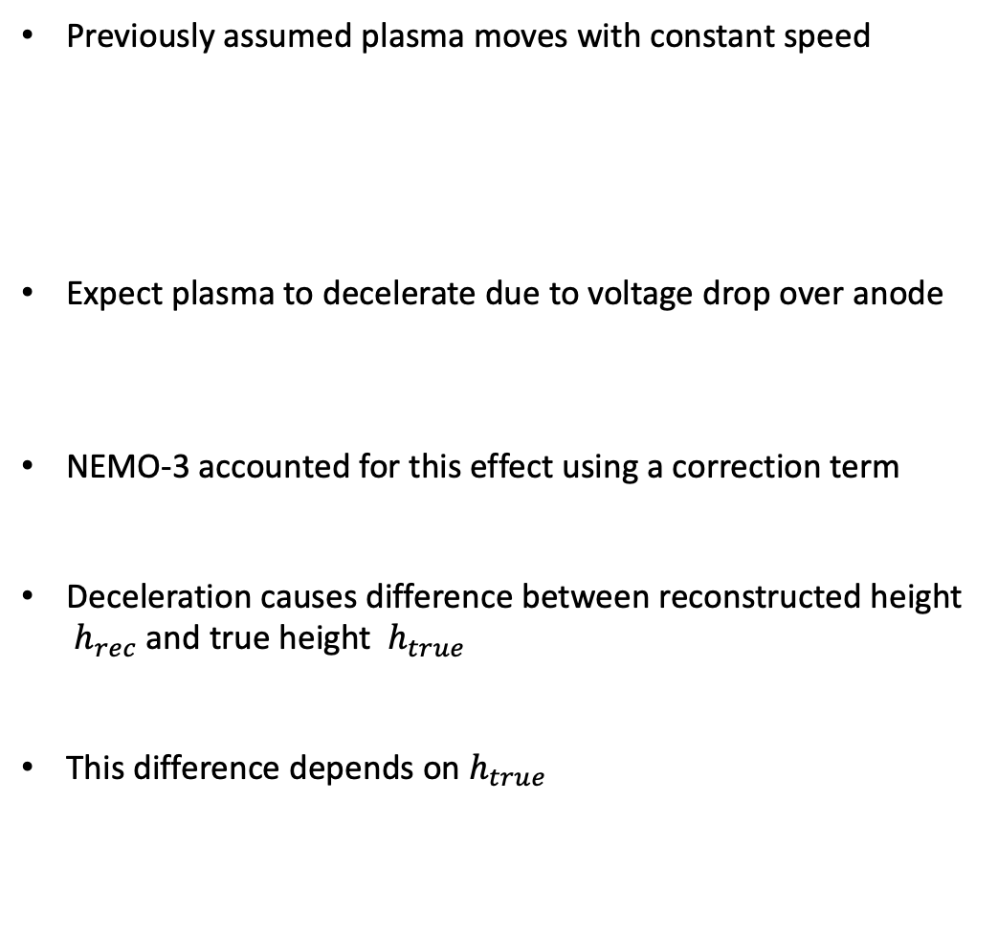
Assumption 1 – Constant Plasma Speed
Previously assumed plasma moves with constant speed
Expect plasma to decelerate due to voltage drop over anode
NEMO-3 accounted for this effect using a correction term
Deceleration causes difference between reconstructed height ${ h}_{rec}$ and true height${ h}_{true}$
This difference depends on${ h}_{true}$
H
h
$$h=\frac{H^{′}}{2}∙\frac{d_{1}−d_{2}}{d_{1}+d_{2}}$$
$$h=\frac{H}{2}∙\frac{t_{bot}−t_{top}}{t_{bot}+t_{top}−2t_{0}}$$
$$d_{1}$$
$$d_{2}$$
$$h_{rec}−h_{true}$$
$$\frac{−H}{2}$$
$$h_{true}$$
$$\frac{H}{2}$$

Slide 19
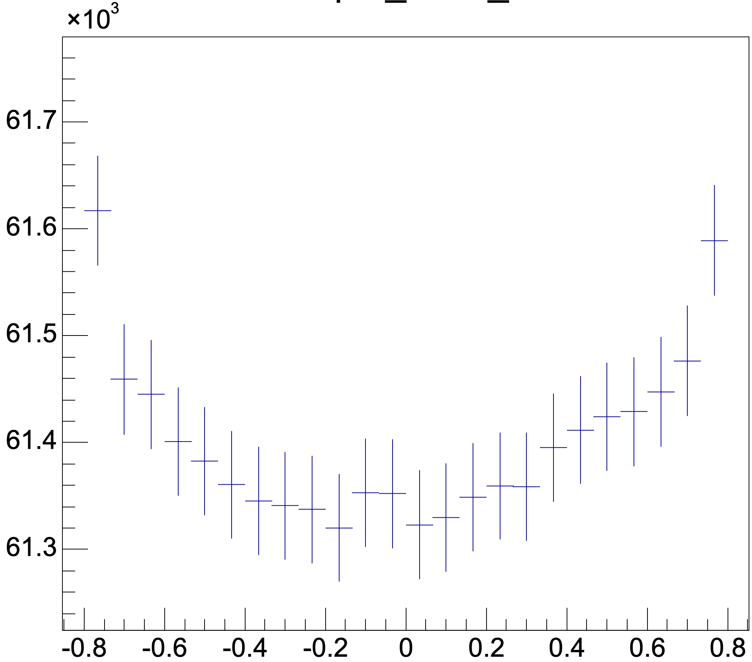
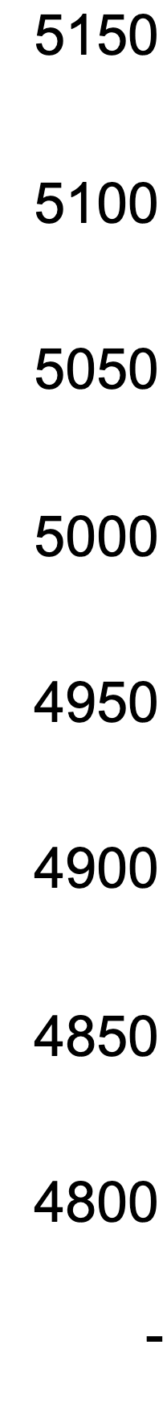
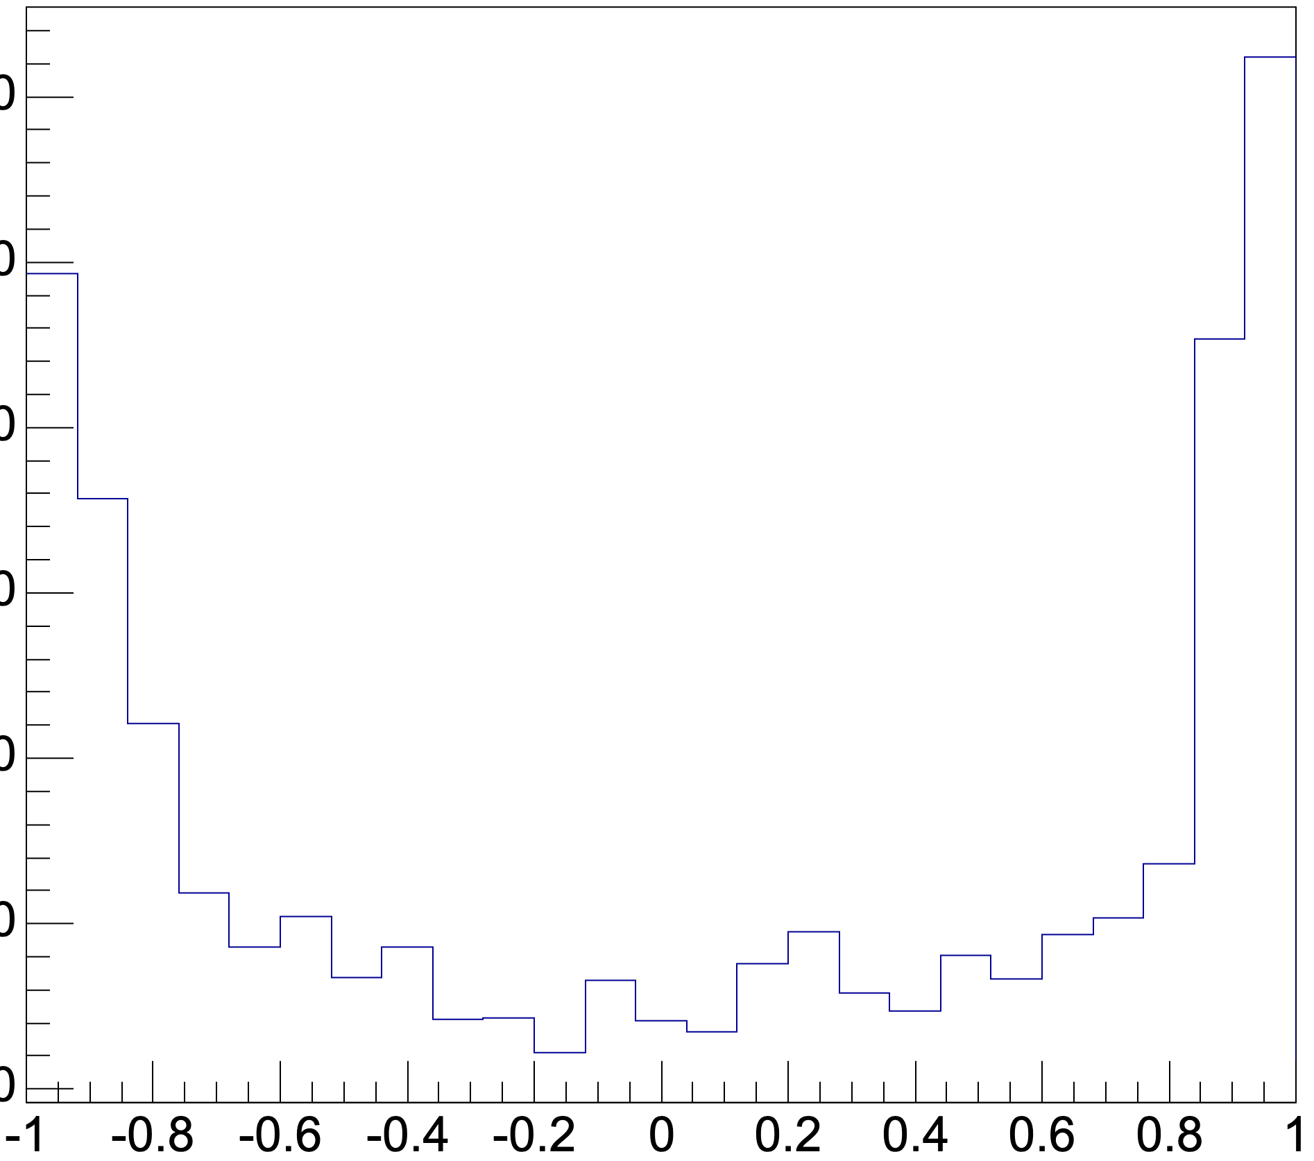
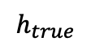
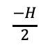
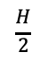
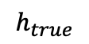
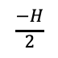
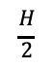
Evidence of Deceleration
Propagation time depends on $h_{rec}$ - 2% effect in prop time at max
Individual Cell
Propagation time (ns)
Propagation time (10ns)
$$\frac{−H}{2}$$
$$h_{true}$$
$$\frac{H}{2}$$
$$\frac{−H}{2}$$
$$h_{true}$$
$$\frac{H}{2}$$

Slide 20
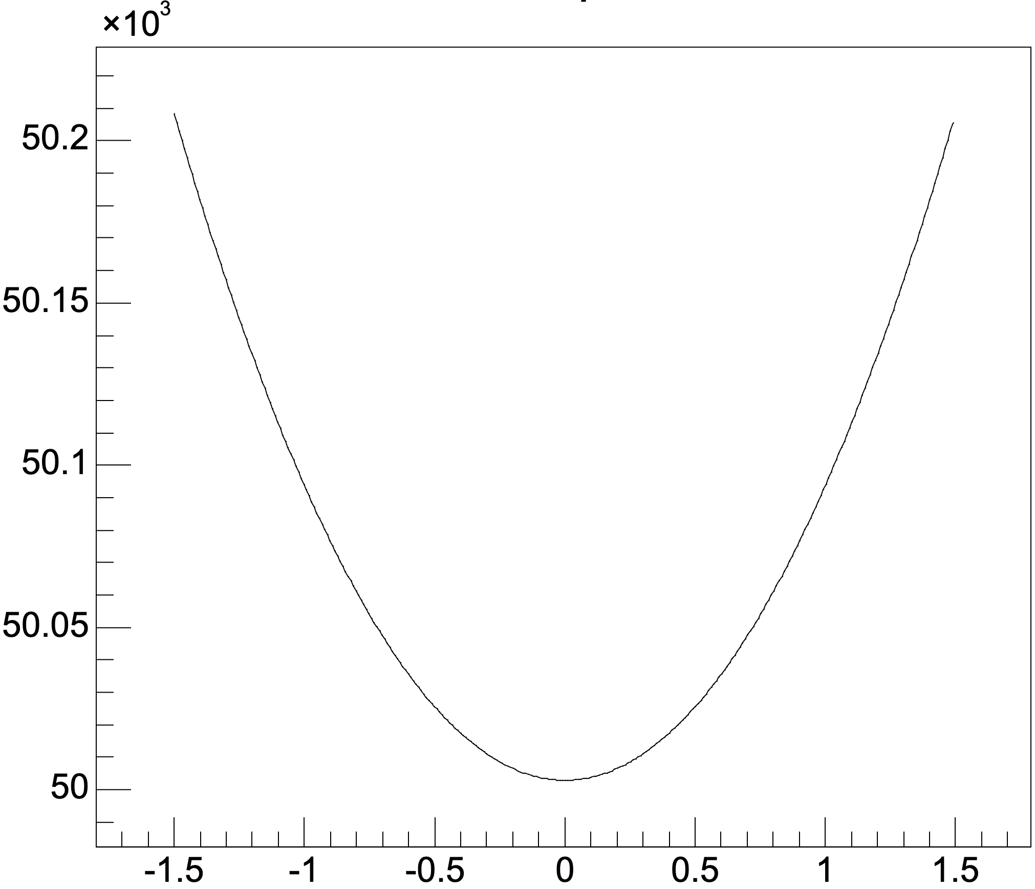
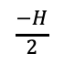
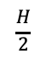
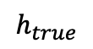
Evidence of Deceleration
Propagation time depends on $h_{rec}$ - 2% effect in prop time at max
Individual Cell
Expected
Propagation time (ns)
Propagation time (10ns)
Propagation time (ns)
$$\frac{−H}{2}$$
$$h_{true}$$
$$\frac{H}{2}$$
$$\frac{−H}{2}$$
$$h_{true}$$
$$\frac{H}{2}$$
$$\frac{−H}{2}$$
$$h_{true}$$
$$\frac{H}{2}$$

Slide 21
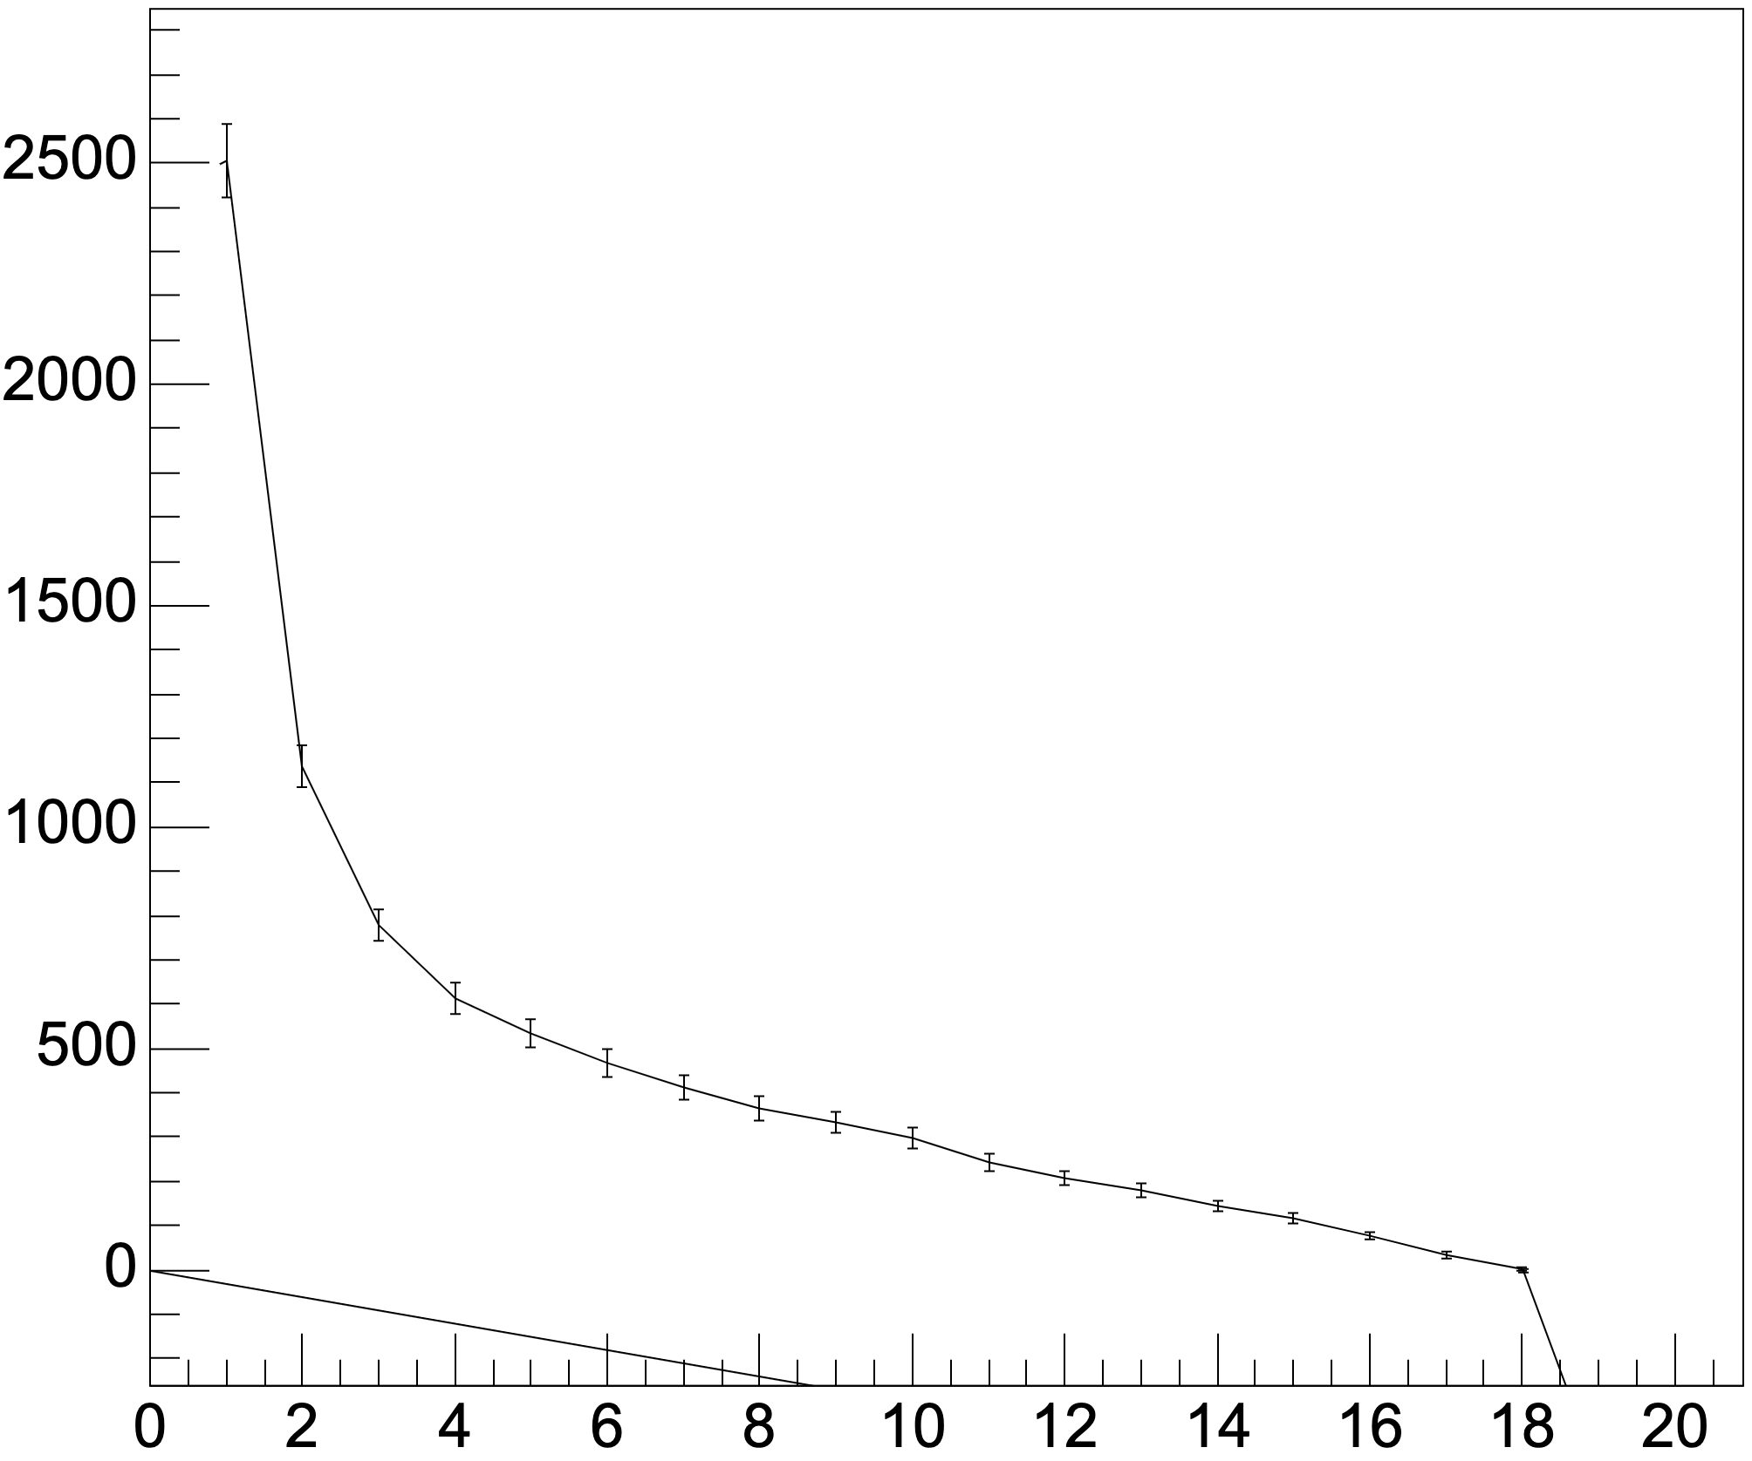
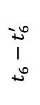
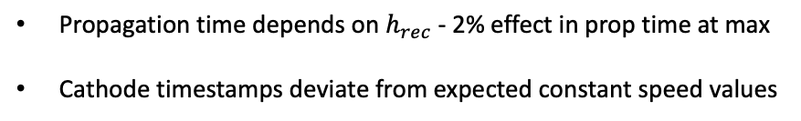
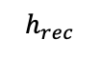
Evidence of Deceleration
Propagation time depends on $h_{rec}$ - 2% effect in prop time at max
Cathode timestamps deviate from expected constant speed values
Individual Cell
Propagation time (ns)
Propagation time (10ns)
$$t_{6}−t_{6}^{′}$$
$$\frac{−H}{2}$$
$$h_{true}$$
$$\frac{H}{2}$$
$$\frac{H}{2}$$
$$h_{rec}$$
$$\frac{−H}{2}$$
$$h_{true}$$
** NEMO-3 used model of changing deceleration – this could be left over effect or something else

Slide 22
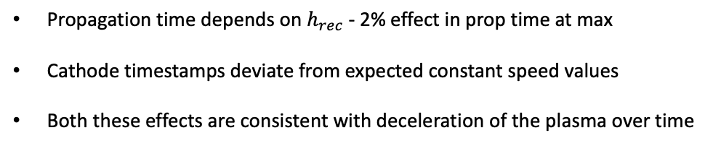
Evidence of Deceleration
Propagation time depends on $h_{rec}$ - 2% effect in prop time at max
Cathode timestamps deviate from expected constant speed values
Both these effects are consistent with deceleration of the plasma over time
Individual Cell
Propagation time (ns)
Propagation time (10ns)
$$t_{6}−t_{6}^{′}$$
$$\frac{−H}{2}$$
$$h_{true}$$
$$\frac{H}{2}$$
$$\frac{H}{2}$$
$$h_{rec}$$
$$\frac{−H}{2}$$
$$h_{true}$$
** NEMO-3 used model of changing deceleration – this could be left over effect or something else

Slide 23
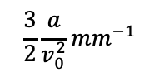
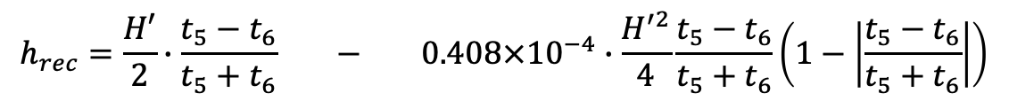
Correction
NEMO-3 correction
$$h_{rec}=\frac{H′}{2}∙\frac{t_{5}−t_{6}}{t_{5}+t_{6}} − 0.408×{10}^{−4}∙\frac{H^{′2}}{4}\frac{t_{5}−t_{6}}{t_{5}+t_{6}}\left(1−\left|\frac{t_{5}−t_{6}}{t_{5}+t_{6}}\right|\right)$$
Current formula
$$\frac{3}{2}\frac{a}{v_{0}^{2}}{mm}^{−1}$$
Deceleration term
Basis of nemo-3 correction:
Assumes deceleration halves during propagation
Benefits of nemo-3 correction:
Unitless correction values
Can be customized for each cell/depending on location of cell
$$h_{rec}−h_{true}$$
$$\frac{−H}{2}$$
$$h_{true}$$
$$\frac{H}{2}$$

Slide 24
New Results Using Bi-207 Sources

Slide 25
Using the Bismuth Sources
Looking for further affects of deceleration and calibrating correction
Bi-207 Sources
Tracker

Slide 26
Using the Bismuth Sources
Looking for further affects of deceleration and calibrating correction

Slide 27
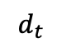
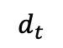
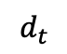
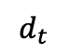
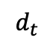
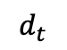
Using the Bismuth Sources
Looking for further affects of deceleration and calibrating correction
The Bismuth sources have a known spacing in the tracker (42.5cm)
$$d_{t}$$
$$d_{t}$$
$$d_{t}$$
$$d_{t}$$
$$d_{t}$$
$$d_{t}$$

Slide 28
Using the Bismuth Sources
Looking for further affects of deceleration and calibrating correction
The Bismuth sources have a known spacing in the tracker (42.5cm)
The effects of plasma deceleration mean the measured positions of the sources will be shifted from their true value

Slide 29
Using the Bismuth Sources
Looking for further affects of deceleration and calibrating correction
The Bismuth sources have a known spacing in the tracker (42.5cm)
The effects of plasma deceleration mean the measured positions of the sources will be shifted from their true value
Exaggerated effects are shown here

Slide 30
Using the Bismuth Sources
Looking for further affects of deceleration and calibrating correction
The Bismuth sources have a known spacing in the tracker (42.5cm)
The effects of plasma deceleration mean the measured positions of the sources will be shifted from their true value
Exaggerated effects are shown here
Note the middle and end source positions don’t change

Slide 31
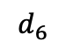
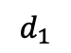
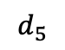
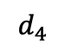
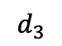
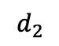
Using the Bismuth Sources
Looking for further affects of deceleration and calibrating correction
The Bismuth sources have a known spacing in the tracker (42.5cm)
The effects of plasma deceleration mean the measured positions of the sources will be shifted from their true value
Exaggerated effects are shown here
Note the middle and end source positions don’t change
The relative source positions should now follow a predictable trend
$$d_{1}$$
$$d_{2}$$
$$d_{3}$$
$$d_{4}$$
$$d_{5}$$
$$d_{6}$$

Slide 32




Using the Bismuth Sources
Looking for further affects of deceleration and calibrating correction
$$d_{1}$$
$$d_{2}$$
$$d_{3}$$
$$h_{rec}−h_{true}$$
$$d_{4}$$
$$d_{5}$$
$$d_{6}$$
$$\frac{−H}{2}$$
$$h_{rec}$$
$$\frac{H}{2}$$

Slide 33
Recovering Edge Sources
Currently we can’t obtain straight angle data from the edge sources due to trigger restrictions
1
2
3
4
5
6
7

Slide 34
Recovering Edge Sources
Currently we can’t obtain straight angle data from the edge sources due to trigger restrictions
Have used angle information from Tomas’ tracking to recover data from these sources
1
2
3
4
5
6
7

Slide 35
Recovering Edge Sources
Currently we can’t obtain straight angle data from the edge sources due to trigger restrictions
Have used angle information from Tomas’ tracking to recover data from these sources
Results in higher uncertainty on position measurement
(Angle is calculated using data uncorrected for deceleration but the scale of this effect has
been account for)
1
2
3
4
5
6
7

Slide 36
Recovering Edge Sources
Currently we can’t obtain straight angle data from the edge sources due to trigger restrictions
Have used angle information from Tomas’ tracking to recover data from these sources
Results in higher uncertainty on position measurement
(Angle is calculated using data uncorrected for deceleration but the scale of this effect has
been account for)
For new runs this restriction will be removed
Once have enough data can reperform analysis using straight angle tracks
1
2
3
4
5
6
7

Slide 37







Results
Data for an individual cell
Expected Trend
$$h_{rec}−h_{true}$$
$$h_{rec}−h_{true}$$
$$\frac{−H}{2}$$
$$h_{rec}$$
$$\frac{H}{2}$$
$$h_{rec}$$

Slide 38


What is plotted?
1
1
True position of source
(relative to central source)
Data for an individual cell
2
Measured position of source
2
3
3
4
4
$$h_{rec}−h_{true}$$
5
5
6
6
7
7
$$h_{rec}$$

Slide 39





Example plots from different cells

Slide 40
Metrics for the Cell
H

Slide 41
Metrics for the Cell
How/where/when the plasma stops moving in the cathode ring affects the effective height of the cell
H

Slide 42

Metrics for the Cell
How/where/when the plasma stops moving in the cathode ring affects the effective height of the cell
$$h_{rec}=\frac{H′}{2}∙\frac{t_{5}−t_{6}}{t_{5}+t_{6}} − k∙\frac{H^{′2}}{4}\frac{t_{5}−t_{6}}{t_{5}+t_{6}}\left(1−\left|\frac{t_{5}−t_{6}}{t_{5}+t_{6}}\right|\right)$$
H

Slide 43
Metrics for the Cell
How/where/when the plasma stops moving in the cathode ring affects the effective height of the cell
$$h_{rec}=\frac{H′}{2}∙\frac{t_{5}−t_{6}}{t_{5}+t_{6}} − k∙\frac{H^{′2}}{4}\frac{t_{5}−t_{6}}{t_{5}+t_{6}}\left(1−\left|\frac{t_{5}−t_{6}}{t_{5}+t_{6}}\right|\right)$$
H
Our correction is sensitive to this height value

Slide 44
Effective height
At the time of installation the sources had a spacing of 42.5cm
42.5cm

Slide 45



Effective height
At the time of installation the sources had a spacing of 42.5cm
The shape of the plot depends on the effective height I select
42.5cm
H’=2.9
$$h_{rec}−h_{true}$$
$$h_{rec}$$

Slide 46



Effective height
At the time of installation the sources had a spacing of 42.5cm
The shape of the plot depends on the effective height I select
I can shift the height value until the difference is minimized
42.5cm
H’=2.9
H’=2.8
$$h_{rec}−h_{true}$$
$$h_{rec}−h_{true}$$
$$h_{rec}$$
$$h_{rec}$$

Slide 47


Effective height
At the time of installation the sources had a spacing of 42.5cm
The shape of the plot depends on the effective height I select
I can shift the height value until the difference is minimized
42.5cm
H’=2.9
H’=2.8
H’=2.77
$$h_{rec}−h_{true}$$
$$h_{rec}−h_{true}$$
$$h_{rec}−h_{true}$$
$$h_{rec}$$
$$h_{rec}$$
$$h_{rec}$$

Slide 48
Effective height
At the time of installation the sources had a spacing of 42.5cm
The shape of the plot depends on the effective height I select
I can shift the height value until the difference is minimized
42.5cm
H’=2.9
H’=2.8
H’=2.77
$$h_{rec}−h_{true}$$
$$h_{rec}−h_{true}$$
$$h_{rec}−h_{true}$$
$$h_{rec}$$
$$h_{rec}$$
$$h_{rec}$$
This height calculation is very dependent on the known source spacing value and upper and lower source position reconstruction (which have the largest uncertainties)

Slide 49





Calibrating the Correction
K=0 $m^{−1}$
K=0.02$m^{−1}$
***
$$h_{rec}=\frac{H′}{2}∙\frac{t_{5}−t_{6}}{t_{5}+t_{6}} − k∙\frac{H^{′2}}{4}\frac{t_{5}−t_{6}}{t_{5}+t_{6}}\left(1−\left|\frac{t_{5}−t_{6}}{t_{5}+t_{6}}\right|\right)$$
We can see the effect has been reduced:
***Note: this plot is a very rough indication of the correction effect, this first analysis is heavily dependent on knowledge of angle so the data must be
Refitted in tracking using the new height reconstruction

Slide 50
Next steps
Repeat Analysis with 0 angle track data after new data is gathered

Slide 51
Next steps
Repeat Analysis with 0 angle track data after new data is gathered
Investigate variation of ‘best’ effective height between cells

Slide 52
Next steps
Repeat Analysis with 0 angle track data after new data is gathered
Investigate variation of ‘best’ effective height between cells
Extract deceleration calibration constant for each cell

Slide 53
Next steps
Repeat Analysis with 0 angle track data after new data is gathered
Investigate variation of ‘best’ effective height between cells
Extract deceleration calibration constant for each cell
Repeat analysis using data from a bismuth run with sources in new positions?

Slide 54
Timestamp Shift Effect

Slide 55
Timestamp shift effect
Propagation time -> time for plasma to travel across the entire cell
True drift radius
Birds eye view
Side view

Slide 56
Timestamp shift effect
Propagation time -> time for plasma to travel across the entire cell
Drift time -> Time for avalanche to travel from ionization point to the anode wire
True drift radius
Birds eye view
Side view

Slide 57
Timestamp shift effect
Propagation time -> time for plasma to travel across the entire cell
Drift time -> Time for avalanche to travel from ionization point to the anode wire
These two times should be independent to one another
True drift radius
Birds eye view
Side view

Slide 58
Timestamp shift effect
Propagation time -> time for plasma to travel across the entire cell
Drift time -> Time for avalanche to travel from ionization point to the anode wire
These two times should be independent to one another
Any dependance suggests the timestamps are mismeasured and need correcting
True drift radius
Anode waveform
T0 - Anode
T1,T2 - Anode
T3,T4 –Anode
Birds eye view
Voltage amplitude
Time
Side view

Slide 59



Evidence of height dependent TS correction effects
Fix/add more events!!!!
Propagation time
Propagation time average
Drift time (ns)
Drift time (ns)

Slide 60
Evidence of height dependent TS correction effects
Fix/add more events!!!!
Propagation time
Propagation time average
Drift time (ns)
Drift time (ns)
Dependance of propagation time on drift time ~ 10% effect

Slide 61
Evidence of height dependent TS correction effects
Fix/add more events!!!!
Propagation time
Propagation time average
Drift time (ns)
Drift time (ns)
Dependance of propagation time on drift time ~ 10% effect
Delay between avalanche reaching anode and plasma propagation

Slide 62
Evidence of height dependent TS correction effects
Fix/add more events!!!!
Propagation time
Propagation time average
Drift time (ns)
Drift time (ns)
Dependance of propagation time on drift time ~ 10% effect
Delay between avalanche reaching anode and plasma propagation
This delay depends on drift

Slide 63
Evidence of height dependent TS correction effects
Fix/add more events!!!!
Anode waveform
t1-t0
Propagation time
Propagation time average
Voltage amplitude
Drift time (ns)
Drift time (ns)
Time
Dependance of propagation time on drift time ~ 10% effect
Delay between avalanche reaching anode and plasma propagation
This delay depends on drift
‘jitter’ in signal or physical effect eg. Acceleration

Slide 64
Evidence of height dependent TS correction effects
Fix/add more events!!!!
t1-t0
Propagation time
Propagation time average
Drift time (ns)
Drift time (ns)
Dependance of propagation time on drift time ~ 10% effect
Delay between avalanche reaching anode and plasma propagation
This delay depends on drift
‘jitter’ in signal or physical effect eg. Acceleration
correct t0 as a metric for when plasma starts to move vertically

Slide 65
Evidence of height dependent TS correction effects
Non-linear region
Noise/lowcount
Propagation time average
Linear region
Flat/low count
Drift time (ns)

Slide 66

Evidence of height dependent TS correction effects
$t_{prop}^{′}=t_{prop}+C$ $∙t_{drift}$
Propagation time average
$t_{prop}^{′}=t_{prop}+C$ $∙t_{drift}$
Drift time (ns)

Slide 67


Evidence of height dependent TS correction effects
$t_{prop}^{′}=t_{prop}+C$ $∙t_{drift}$
$$h^{′}=\frac{H}{2}∙\frac{t_{1}−t_{2}}{t_{1}+t_{2}}$$
$$h=\frac{H}{2}∙\frac{t_{1}−t_{2}}{t_{1}+t_{2}−C∙t_{drift}}$$
Propagation time average
$t_{prop}^{′}=t_{prop}+C$ $∙t_{drift}$
Drift time (ns)

Slide 68
Evidence of height dependent TS correction effects
$t_{prop}^{′}=t_{prop}+C$ $∙t_{drift}$
$$h^{′}=\frac{H}{2}∙\frac{t_{1}−t_{2}}{t_{1}+t_{2}}$$
$$h=\frac{H}{2}∙\frac{t_{1}−t_{2}}{t_{1}+t_{2}−C∙t_{drift}}$$
Propagation time average
Effect could be > cm
$t_{prop}^{′}=t_{prop}+C$ $∙t_{drift}$
Drift time (ns)

Slide 69
Evidence of height dependent TS correction effects
$t_{prop}^{′}=t_{prop}+C$ $∙t_{drift}$
$$h^{′}=\frac{H}{2}∙\frac{t_{1}−t_{2}}{t_{1}+t_{2}}$$
$$h=\frac{H}{2}∙\frac{t_{1}−t_{2}}{t_{1}+t_{2}−C∙t_{drift}}$$
Propagation time average
Effect could be > cm
Ways to correct:
Shift calo timestamps depending on drift time
Have a calibration constant, C, unique to each cell
$t_{prop}^{′}=t_{prop}+C$ $∙t_{drift}$
Drift time (ns)

Slide 70
Evidence of height dependent TS correction effects
$t_{prop}^{′}=t_{prop}+C$ $∙t_{drift}$
$$h^{′}=\frac{H}{2}∙\frac{t_{1}−t_{2}}{t_{1}+t_{2}}$$
$$h=\frac{H}{2}∙\frac{t_{1}−t_{2}}{t_{1}+t_{2}−C∙t_{drift}}$$
Propagation time average
Effect could be > cm
Ways to correct:
Shift calo timestamps depending on drift time
Have a calibration constant, C, unique to each cell
$t_{prop}^{′}=t_{prop}+C$ $∙t_{drift}$
Drift time (ns)

Slide 71
New Results Using Bi-207 Sources

Slide 72
Bi-207 Timestamp shift effect
Based on previous results we expect our height measurement to depend on drift time

Slide 73
Bi-207 Timestamp shift effect
Based on previous results we expect our height measurement to depend on drift time
The measured positions of our sources should shift with drift time

Slide 74

Bi-207 Timestamp shift effect
Based on previous results we expect our height measurement to depend on drift time
The measured positions of our sources should shift with drift time
Do we see this effect?
$$h=\frac{H}{2}∙\frac{t_{1}−t_{2}}{t_{1}+t_{2}−C∙t_{drift}}$$

Slide 75








Bi-207 Timestamp shift effect
Based on previous results we expect our height measurement to depend on drift time
The measured positions of our sources should shift with drift time
Do we see this effect?
$$h=\frac{H}{2}∙\frac{t_{1}−t_{2}}{t_{1}+t_{2}−C∙t_{drift}}$$
$$h_{rec}−h_{true}$$
$$h_{rec}−h_{true}$$
$$\frac{−H}{2}$$
$$H$$
$$\frac{H}{2}$$
$$t_drift$$
We would expect the shift to be on a scale of 1cm

Slide 76


Bi-207 Timestamp shift effect
-1.5
0
1.5
$$height m$$
Look at dependance of this peak position on drift time

Slide 77








Bi-207 Timestamp shift effect
Non-linear region
Non-linear region
$$height m$$
$$height m$$
-1.5
0
1.5
$$drift time$$
$$drift time$$
$$height m$$
We see effect ~ 1cm
Look at dependance of this peak position on drift time
$$h_{rec}$$
$$t_drift$$

Slide 78
Timestamp correction next steps
Investigate relation between position shift and propagation time rise more

Slide 79
Timestamp correction next steps
Investigate relation between position shift and propagation time rise more
See if timestamp correction reduces this effect

Slide 80
Timestamp correction next steps
Investigate relation between position shift and propagation time rise more
See if timestamp correction reduces this effect
Calibrate correction for each cell

Slide 81
Timestamp correction next steps
Investigate relation between position shift and propagation time rise more
See if timestamp correction reduces this effect
Calibrate correction for each cell
Investigate any overlap between the timestamp shift and deceleration effect

Slide 82
Summary
Deceleration and timestamp shift effects have been seen in the bismuth source data

Slide 83
Summary
Deceleration and timestamp shift effects have been seen in the bismuth source data
Using the sources has allowed for more accurate estimation of the scale of these effects

Slide 84
Summary
Deceleration and timestamp shift effects have been seen in the bismuth source data
Using the sources has allowed for more accurate estimation of the scale of these effects
Other information learned about tracker structure (effective height)

Slide 85
Summary
Deceleration and timestamp shift effects have been seen in the bismuth source data
Using the sources has allowed for more accurate estimation of the scale of these effects
Other information learned about tracker structure (effective height)
Calibrations for each cell can now be made to correct for these effects

Slide 86
Extra

Slide 87



Anode time reconstruction
Anode
Current height formula
$$h=\frac{H}{2}∙\frac{t_{bot}−t_{top}}{t_{bot}+t_{top}−2t_{0}}$$
H
t0
$$h=\frac{H}{2}∙\frac{t_{bot}−t_{top}}{t_{bot}+t_{top}−2t_{0}}$$
h
$$d_{1}$$
$$d_{2}$$
$$h=\frac{H}{2}∙\frac{t_{bot}−t_{top}}{t_{bot}+t_{top}−2t_{0}}$$
Could also use anode timestamps as replacements
To be discussed later
Time

Slide 88
Assumptions made in reconstruction
Constant plasma speed:
Timestamps do not need to be corrected before being used in reconstruction
Voltage
Time
Angle of track doesn’t affect our ability to reconstruct
$$θ$$
(+ others …)
All these assumptions break down at some scale. Goal is to find scale at which they break and estimate uncertainties as a result.
Methods for correcting these effects have also been suggested.

Slide 89
Assumption 3 – Angle of track doesn’t affect reconstruction ability
Drift radius

Slide 90
Assumption 3 – Angle of track doesn’t affect reconstruction ability
Multiple ionisations occur
Drift radius
Using proportional height calculation we get the wrong height!
Correct drift time, incorrect propagation time

Slide 91

Evidence of angle effect

Slide 92
Correct for Angle Effect

Slide 93



Further Assumption – Effective Height
H
Where in the cathode ring does the plasma movement stop
Or ’At what position are the cathode time measurements taken’
Answer changes effective height of cell H’ in the equation
If $H ′<H$ all heights will be shifted to centre of cell
Due to different electric field within cathode rings
(nemo-3 made a correction)
$$h=\frac{H^{′}}{2}∙\frac{t_{1}−t_{2}}{t_{1}+t_{2}}$$

Slide 94
Further Assumption – Nearest Ionisation
Drift radius

Slide 95
Further Assumption – Nearest Ionisation
Ionisation did not take place at nearest point of crossing e- to anode wire
Drift radius

Slide 96
Further Assumption – Nearest Ionisation
Drift radius
True drift radius
measured drift radius
can we take this into account?
Measure correct propagation time but incorrect (overestimated) drift time

Slide 97
Further Assumption – Edge Drift Effect
Looked into by NEMO-3
Hard to study in SuperNEMO due to trigger
Minor effect

Slide 98





Extra – Deceleration Cause Slide 1
Speed of plasma $∝$ $V_{A}\left(t\right)$
Deceleration $≈$ $\frac{i_{0}}{C_{2}}$
Anode wire
$$V_{A}\left(t\right)−V_{H}=−Ri_{0}\left(1−e^{−\frac{t}{RC_{2}}}\right)≈−\frac{i_{0}t}{C_{2}}$$
…
$$C_{2}$$
…
$V_{A}$Anode voltage
$V_{H}$ High voltage value
$C_{2}$ Capacatance
R Resistance (components not shown)
As a plasma propagates over the anode more and more charge is added
The change in potential over the anode corresponds to the discharging of the connected capacitor
This approximates to a linear change in electric field
Linear deceleration of the plasma results
NEMO-3 prototype data
NEMO-3 studied this effect with a prototype tracker
No such study using laser triggering was done on the SN prototype

Slide 99



Extra – Deceleration Cause Slide 2
$$V_{A}\left(t\right)−V_{H}=−Ri_{0}\left(1−e^{−\frac{t}{RC_{2}}}\right)≈−\frac{i_{0}t}{C_{2}}$$
Very similar designs – Ask about checking if equation is still valid!
NEMO-3 Cell Design
SuperNEMO Cell Design

Slide 100


Extra – Deceleration Cause Slide 3
$$V_{A}\left(t\right)−V_{H}=−Ri_{0}\left(1−e^{−\frac{t}{RC_{2}}}\right)≈−\frac{i_{0}t}{C_{2}}$$
Deceleration $≈$ $\frac{i_{0}}{C_{2}}$
Scale in NEM0-3:
Scale in SuperNEMO:
C2 =1nF
R = 220k$Ω$
Dec =
RC2 =220 ms
Tp = 40 us
Tp/RC2 = 2e-4
H = ?
C2 =2.2nF
R = 470k$Ω$
Dec =
RC2 = 1034 ms
Tp = 60 us
Tp/RC2 = 2e-5
H = 3m
Summary:
Has this not been looked into at all in Manchester when testing the
Cells? – look up some more documentation!
Note: io depends on the gas mixture - so will change
If SN has more ionizations per second due to larger E field maybe discharge s quicker?

Slide 101

Extra – Deceleration Cause Slide 4
Note this was in the anode times not the cathode times
End goal is to use width of distributions to estimate the uncertainty anyway!

Slide 102


Extra – Deceleration Evidence Slide 1
Width of gaussian increases – statistical way plasma moves
Skew of gaussian increases - deceleration effect
Graph is not a straight line – deceleration effect
Centre of guassian to edge of skew:
2000 at low time
8000 at high time
6000 ns timestamp change
t6
T6-t6_linear
Height’
H_rec

Slide 103






Extra – Deceleration Model Slide 1
Model 1 – Constant deceleration
Model 2 – Deceleration ½’s when one plasma reaches near cathode
(model NEMO-3 used based off discharge argument )
Model 1
Model 2
$$V_{A}\left(t\right)−V_{H}=−Ri_{0}\left(1−e^{−\frac{t}{RC_{2}}}\right)≈−\frac{i_{0}t}{C_{2}}$$
$$h_{rec}−h_{true}$$
Note: Model 2 predicts no change in propagation time with height
Is the change in propagation time we see a residual effect ?
$$\frac{−H}{2}$$
$$h_{true}$$
$$\frac{H}{2}$$

Slide 104




Extra – Deceleration Model Slide 2
Model 1 – Constant deceleration
Model 2 – Deceleration ½’s when one plasma reaches near cathode
Position of maxima shift between models
Model 1
Model 2
Note: Model 2 predicts no change in propagation time with height
Is the change in propagation time we see a residual effect ?
$$h_{rec}−h_{true}$$
Model 1
Propagation time
$$\frac{−H}{2}$$
$$h_{true}$$
$$\frac{H}{2}$$
$$\frac{−H}{2}$$
$$h_{true}$$
$$\frac{H}{2}$$

Slide 105


How does the Plasma Move?
1 Plasma starts moving on first ionization:
Assumes don’t need high E field around anode wire to start vertical motion
Anode wire
2 Plasma starts moving when anode quenched:
Assumes high E field needed to produce enough UV’s so that plasma/ionizations can move longitudinally without being stopped by ethanol/quenching gas
Anode wire
$$E=\frac{λ}{2πε_{0}}\frac{1}{r}$$
3 Combination of the two:
***NEMO-3 favoured this explantion (with a big difference)
The plasma moves longitudinally slowly at the start then reaches the wire and moves at full speed
Slow speed at first as less UV emitted in low E region away from anode
Anode wire

Slide 106






Extra - Correction
NEMO-3 correction
$$h_{rec}=\frac{H′}{2}∙\frac{t_{5}−t_{6}}{t_{5}+t_{6}} − 0.408×{10}^{−4}∙\frac{H^{′2}}{4}\frac{t_{5}−t_{6}}{t_{5}+t_{6}}\left(1−\left|\frac{t_{5}−t_{6}}{t_{5}+t_{6}}\right|\right)$$
Current correction
$$\frac{3}{2}\frac{a}{v_{0}^{2}}{mm}^{−1}$$
Deceleration term
Based off approximation
$$\frac{−3}{2}∙\frac{a}{v_{0}}=1−\frac{z_{rec}}{z_{true}}$$
Need to verify we see the same effect as they did
Need to verify way of calculating deceleration value is valid
Benefits of nemo-3 correction:
Unitless correction values
Can be customized for each cell/depending on location of cell
Next steps:
Test how this reconstruction affects tracking/location abilities
Check for evidence of changing acceleration
$$h_{rec1}−h_{rec2}$$
If effect<5mm do we need to correct?
$$h_{rec1}$$
Difference in ts values between current reconstruction and using NEMO-3 reconstruction

Slide 107
Overview of Tracker Cell
Cell View
Sequence of Events
Measured Signals
Recorded Information
Anode
T0 - Anode
T1,T2,Ttop - Anode + Cathode
T3,T4,Tbot – Anode + Cathode
Electron passes through cell
Avalanche triggered in cell
Plasma reaches near cathode
Plasma reaches far cathode
Cathode 1
Time
e-
Time
Cathode 2
Time

Slide 108
Overview of Tracker Cell
Sequence of Events
Measured Signals
Cell View
Anode
Electron passes through cell
Avalanche triggered in cell
Plasma reaches near cathode
Plasma reaches far cathode
t0
t1
t2
t3
t4
Time
Cathode 1
Recorded Information
e-
T0 - Anode
T1,T2,Ttop - Anode + Cathode
T3,T4,Tbot – Anode + Cathode
t5
Time
Cathode 2
t6
Time

Slide 109

Sequence of Events of a Tracker Hit
Fix time scales – alternative plot
Anode
t0
t1
Time
t2
t3
t4

Slide 110
Using the Bismuth Sources
Looking for further affects of deceleration and calibrating correction
$$d_{t}$$
$$d_{t}$$
$$d_{t}$$
$$d_{t}$$
$$d_{t}$$
$$d_{t}$$

Slide 111

Validating angle technique
Can’t obtain straight angle data for the edge sources
1
1
2
2
3
3
Reconstructed height
4
4
5
5
6
6
7
Angle of track
7
**This will change soon – will reperform analysis with straight track data

Slide 112


Height shift of central peak
Position of each measured peak shifts with angle
Tan theta
Gradient is equal to horizontal distance from the source to the cell
Can use this information to project all the events onto the source position – reconstruct source position with calibration by cell
We need to know exact distance from source to cell to do this – if project using coordinates in Falaise the sources appear blurred

Slide 113
The angles we’re initially calculated using coordinates affected by the deceleration – is the technique still valid?

Slide 114


Slide 116

Variation in height estimates from the different sources indicate how
Much the angular correction will be affected by deceleration
- a typical variation of around 1mm
- The gradient for each source will be affected by deceleration differently
- 1mm error cant account for 1cm effect we see in position variation
gradient
Source position

Slide 117
Corrected Angle
This method works because the effect of deceleration within a 10cm range shifts
The measured positions of hits by the same amount to within 2mm
Allowing us to project back to find the position of the source
And then see the larger effect of height differences between sources and their expected positions (~1cm)
Chose cells at the first layer
Range angle from 60 deg to -60 deg
Project heights onto source position (y=z-tan(theta)*t)
At most this could artificially shift the position of data by 2mm (errors shown on height plot)
12cm
End up with a series of defined peaks
(including the edge sources)
t

